Slide 1
INTRODUCTION
TEAM NAME -- TEAM ILLUSION
TEAM LEADER -- ANKUSH KUMAR KOTHIYAL
TEAM MEMBER -- SHUBHAM PAREEK
PROJECT NAME -- SMART FARMING

Slide 2
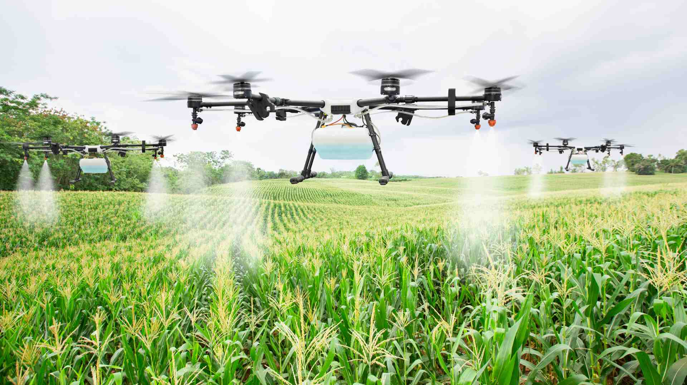
SMART FARMING
This Photo by Unknown Author is licensed under CC BY

Slide 3
PROBLEM STATEMENT
Farming these days requires a lot of manual labor considering a medium sized field in the process of sowing seeds, proper application of Fertilizers/Pesticides and irrigation draining the farmer both mentally and physically. Not all the farmers are physically fit to work 7 days a week. Automating the whole process using a mobile app and Drone can increase the efficiency of the whole process exponentially.

Slide 4
SOLUTION
We will create a automated drone based on artificial intelligence and machine learning. It contains to measure two major components camera and pesticides.
We will create a automated machine which will decide the proper distance between seeds using machine learning algorithm and sowed the seeds into the ground by itself.
We have created a app (KrishiTech) which control all the processes (Running of automated machine sprinkling pesticides) and give the proper information of weather depending upon location.

Slide 5
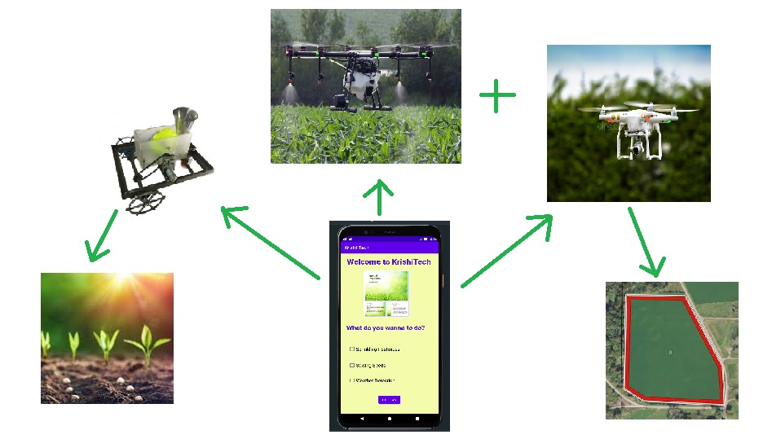
SOLUTION
Sprinkling pesticides
AUTOMATED MACHINE
Proper distance B/W seeds
Boundaries detection using ML
APP

Slide 6
Automated machine
PROPERTIES
Using ml it will find the correct spacing between seeds for proper growth .
We will put it at start point of field and start it.
It will go straight till boundary of field is closer to machine.
Now it will take left and move some distance which is defined according to the seed.(refer figure)
And then turn left again and go straight till the boundary command then take right and move specified distance and then right turn again and so on.
While moving, machine will sow the seeds automatically.

Slide 7
Automated machine
Sowing seeds by automated machine
When the user put the specific seeds into the seed box and select the name of that seed in our app then automated machine will sow the seeds maintaining proper distance between them.
In KrishiTech app, when user select the seed, check all the instructions click on the proceed button. Machine learning will do its work.
According to the seed selected proper distance is calculated and machine will sow the seeds.

Slide 8
Automated machine
working of automated machine video link
https://screenrec.com/share/LFYo0i4tSK

Slide 9
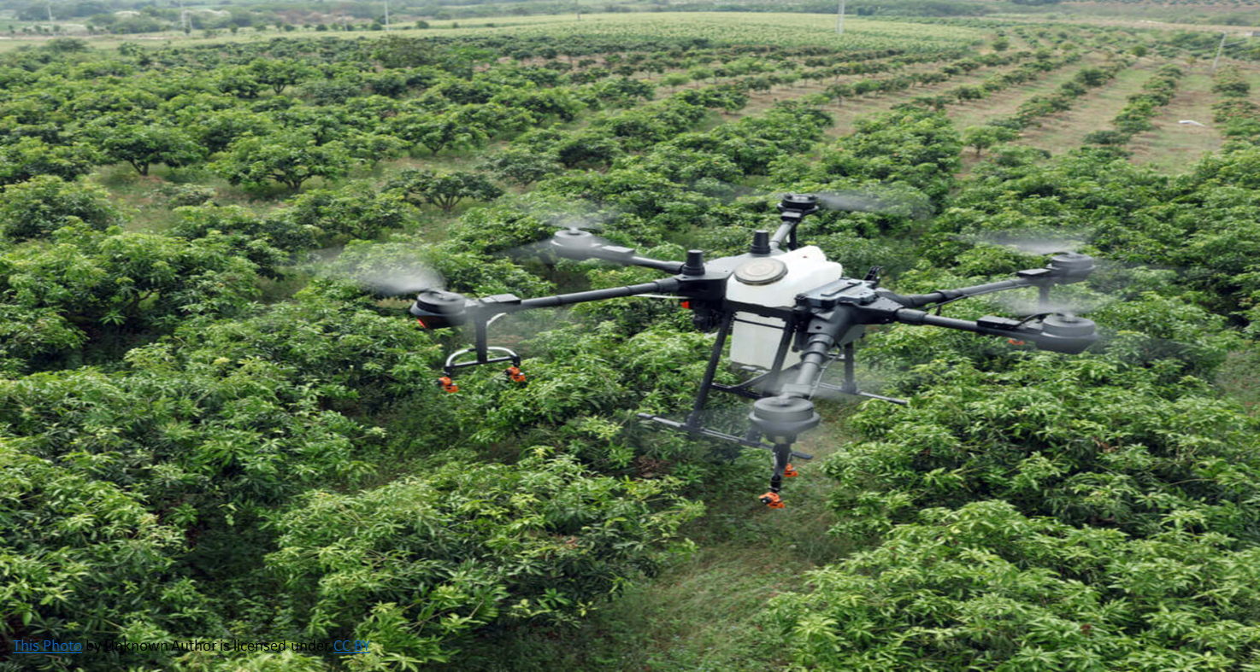
DRONE

Slide 10
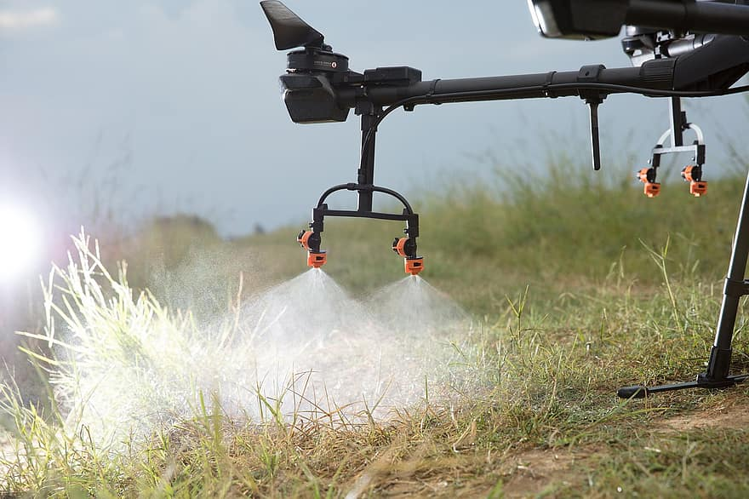
DRONE
To detect Boundaries .
Sprinkling pesticides.
Detection of harmed crops.

Slide 11
drone
Working of drone using camera :
Whole drone working is Artificial intelligence and Machine learning based.
Camera is used to detect boundaries of the field and to check if there
is need to spray pesticides after seeing the whole crop.
Harmed crops will be detected by image recognition with machine learning
and when you give command to the drone to spray pesticides over the
field using app ,drone will start spraying pesticides.
When the spraying is done ,drone automatically stop spraying
pesticides and drone will back to it's initial position.

Slide 12
krishiTech app
All processes are controlled by this app :-
To show the weather condition of that location.
To give the commands for the sprinkling pesticides.
To give the commands for the seed inserter machine(automated machine).

Slide 13
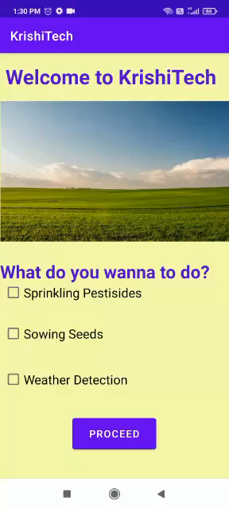
KRISHITECH WORKING

Slide 14
MACHINE LEARNING
Here we will use ml to accomplish some task:-
Through image recognition drone will see the harmed area of crop ,if some area is found harmed then it will start sprinkling the pestisides over the harmed area .
Object detection to find the boundaries of the field.

Slide 15
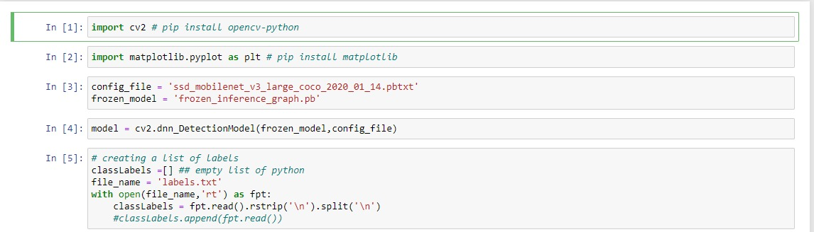
Object detection code
This is the code to detect things which is described in the labels.txt in images and videos (for example car).
we will modify it to detect boundaries of an field with the help of drone.

Slide 16
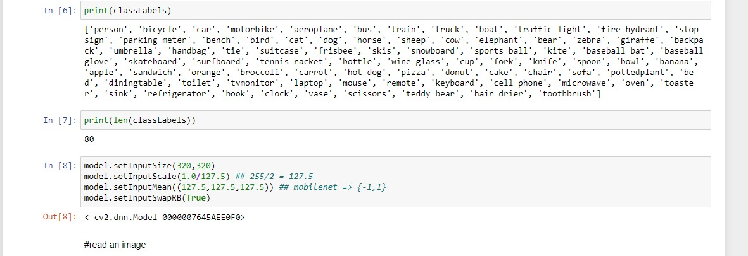
Object detection code

Slide 17
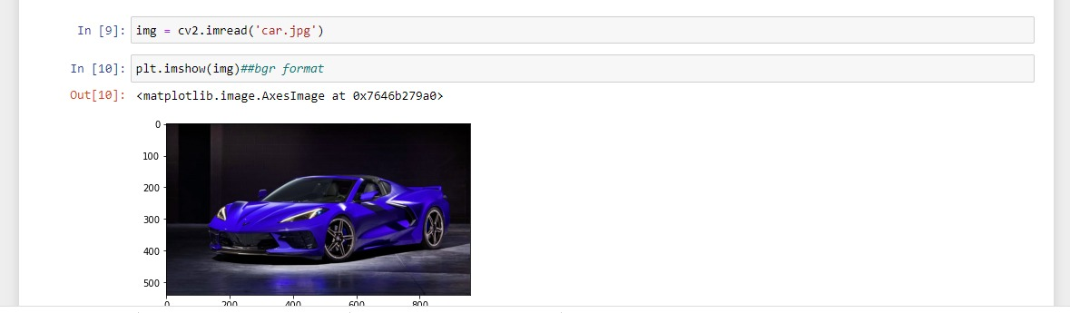
Object detection code

Slide 18
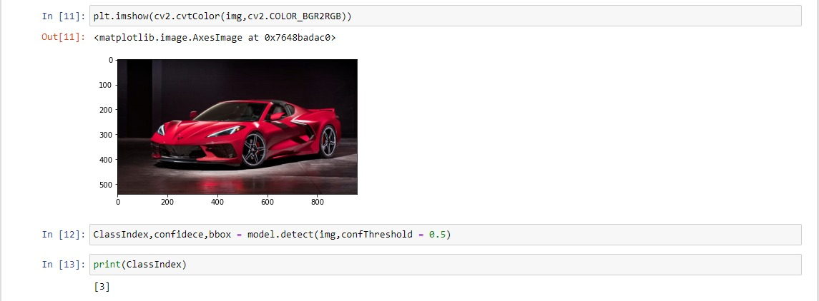
Object detection code

Slide 19
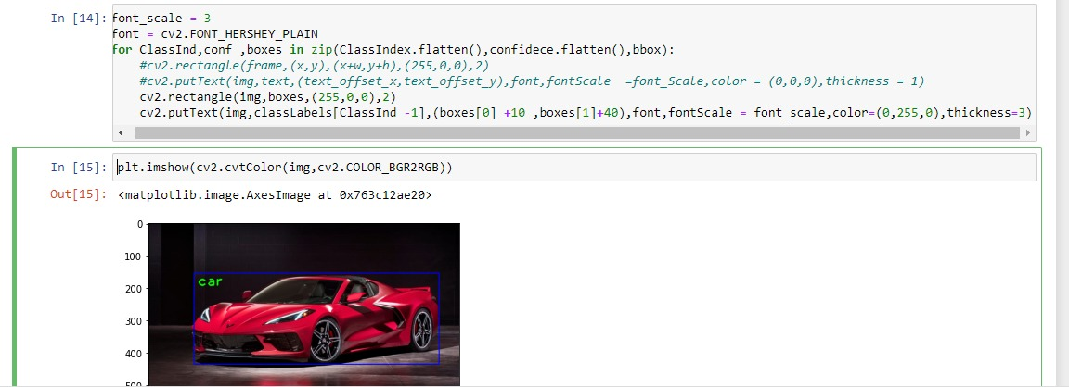
Object detection code

Slide 20
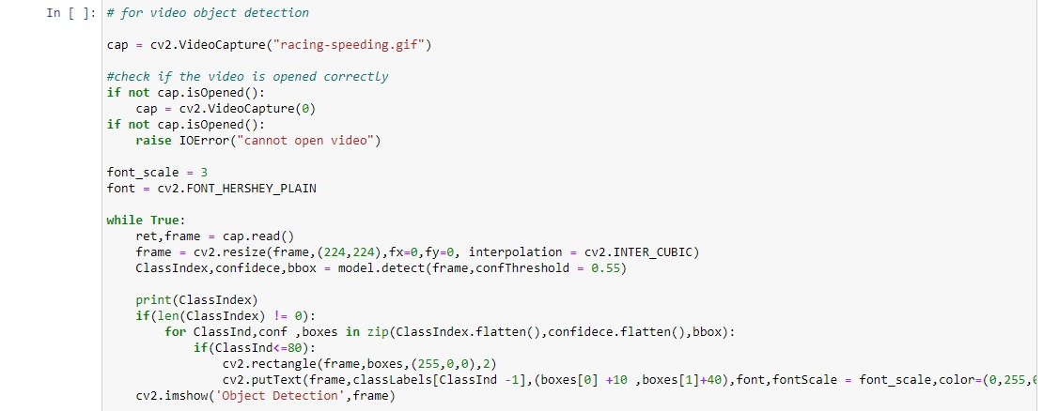
Object detection code

Slide 21
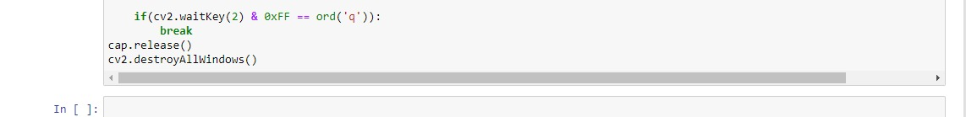
Object detection code

